Slide 1


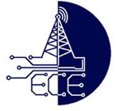
Real-Time Mobile Phone Usage Detection and Automated Ticketing Using YOLO Deep Learning Algorithm
Department of
ELECTRONICS AND COMMUNICATION ENGINEERING
Guided by
DR.C.KUMAR,Ph.D
Presented by
M.VAMSI KRISHNA : 21691A04Q9
P.VENU KUMAR : 21691A04R9
M.VISHNUVARDHAN : 21691A04T0

Slide 2
Introduction
This project introduces an innovative real-time system designed to detect mobile phone usage by two-wheeler drivers and automate the ticketing process, leveraging YOLO (You Only Look Once) and a Raspberry Pi. The system captures live video footage of the driver using a USB web camera and processes it through YOLO for real-time analysis to identify mobile phone usage. Once a violation is detected, the system retrieves vehicle information by scanning the vehicle's RFID card and number plate. An LCD display presents the relevant details, while the RFID reader ensures precise vehicle identification. This automated solution aims to enhance road safety by promptly identifying distracted driving and issuing tickets efficiently.

Slide 3
Literature Survey
Title: Real-Time Vehicle Detection Using YOLO v8 Model
Author: Dr G Paavai Anand, M. A. Saianuush, Moomal Arshth, Sanjay. S
Abstract: This paper explores the application of the YOLOv8 model for real-time vehicle detection. The primary objective is to enhance detection accuracy and speed, focusing on the effectiveness of the YOLOv8 architecture in identifying vehicles within camera feeds. Key metrics such as Mean Squared Error (MSE), Root Mean Squared Error (RMSE), and detection accuracy are used to evaluate model performance. Our findings demonstrate that YOLOv8 provides high detection accuracy and speed, making it suitable for realworld applications in adaptive signal control, prioritizing efficient vehicle detection

Slide 4
Abstract
This project presents a real-time system for detecting mobile phone usage by two-wheeler vehicle drivers and automating the ticketing process using YOLO (You Only Look Once with a Raspberry Pi. The system uses a USB web camera to capture video footage of the driver, while YOLO ananalyze the footage in real time to detect whether the driver is using a mobile phone. Upon detection, the system reads an RFID card to identify the vehicle and scans its number plate. An LCD display is used to show relevant information, and the RFID reader ensures accurate identification of vehicles. This automated system aims to improve road safety by detecting distracted driving behaviors and issuing tickets in a timely and efficient manner.

Slide 5
Existing Method
Existing methods for detecting mobile phone usage by drivers mainly rely on manual enforcement or stationary cameras with limited real-time analysis. These systems typically require human intervention to monitor and issue tickets, which can be time-consuming and inefficient. Moreover, they lack accuracy in detecting mobile phone usage due to the inability to analyze video feeds in real time or assess the actions of drivers consistently. Current systems may also face challenges with environmental conditions, such as varying lighting or angles, which impact the effectiveness of mobile phone detection. Additionally, they often lack the integration of automated ticketing, leading to delays in issuing fines.

Slide 6
Proposed Method
The proposed method utilizes a real-time system powered by YOLO for detecting mobile phone usage by two-wheeler drivers. A USB web camera captures video of the driver, while YOLO analyze the footage for phone usage in real time. Once a phone is detected, an RFID reader scans an RFID card associated with the vehicle, and the vehicle number is read and processed. This system is fully automated, ensuring timely ticket issuance without human intervention. By integrating real-time video analysis and automated ticketing, the system enhances road safety and efficiency in monitoring distracted driving.

Slide 7
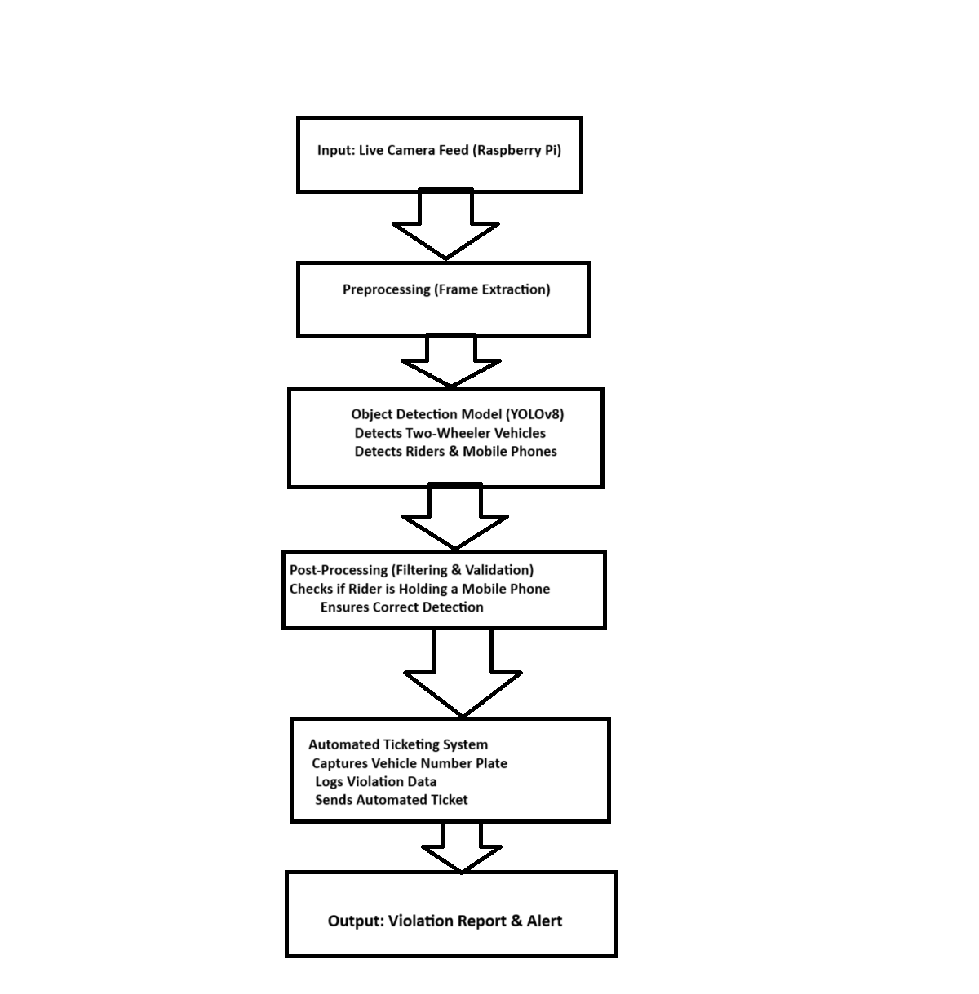
Yolo v8 block diagram

Slide 8
Explanation
Explanation of Each Block
Input (Live Camera Feed from Raspberry Pi)
The system captures a continuous video feed from a camera mounted on a traffic pole or roadside to monitor vehicles.
Preprocessing (Frame Extraction & Enhancement)
Extracts frames from the video feed.
Enhances images for better detection accuracy.
YOLOv8 Object Detection
Two-wheeler detection: Identifies motorcycles and scooters on the road.
Mobile phone detection: Identifies if the rider is using a mobile phone while driving.

Slide 9
Explanation
Post-Processing (Filtering & Validation)
Filters false positives using spatial relationships and confidence thresholds.
Ensures detected mobile phone is in the rider's hand, not in a pocket or on the vehicle.
Automated Ticketing System
Number Plate Recognition (Using SSD or OCR techniques like Tesseract)
Violation Logging: Stores the detected violation in a database with timestamp, vehicle number, and location.
Alert Generation: Sends an automated fine or warning message to the vehicle owner.
Output (Violation Report & Alert)
The detected violations are logged, and necessary authorities or the violator receive notifications

Slide 10
Components
Yolo v8
Raspberry Pi
Memory card
LCD
USB web camera
Tesseract OCR
Power supply

Slide 11
Flow chart of the program
Start
Capture Video (Pi Cam)
Pre-process Frame
(Resize, Normalize)
Run YOLO/SSD Model
Detect Two-Wheeler,
Rider, & Mobile Phone

Slide 12
Flow chart of the program
Check for Violation
(Driver using Phone?)
If YES → Capture Frame
License Plate Detection (OCR to Extract Number)
Save Violation Details (Image, License Plate)
Generate Ticket & Send Notification (Email/SMS)
End

Slide 13
Advantages and Applications
Advantages
Applications
• - Real-time
• - Automated
• - Efficient
• - Accurate
• - Road safety
• - Traffic monitoring
• - Vehicle enforcement
• - Automated ticketing

Slide 14
References
1. Redmon, J., Divvala, S., Girshick, R., & Farhadi, A. (2016). *You Only Look Once: Unified, Real-Time Object Detection*. In Proceedings of the IEEE Conference on Computer Vision and Pattern Recognition (CVPR), 779-788.
2. Zhang, Y., & Xie, L. (2019). *Real-time Object Detection for Mobile Applications Using YOLO*. International Journal of Computer Science and Information Security, 17(4), 23-29.
3. Kumar, A., & Singh, V. (2021). *Mobile Phone Detection for Traffic Safety Using Machine Learning*. Journal of Traffic Safety and Technology, 34(2), 123-132.
4. Wang, Q., & Zhang, L. (2020). *Automatic Vehicle Identification and Ticketing System Using RFID and YOLO-based Driver Behavior Detection*. International Journal of Intelligent Transportation Systems, 18(3), 56-63.
5. Venkatesan, R., & Balamurugan, P. (2021). *IoT-based Automated Traffic Monitoring and Violation Detection System Using YOLO and RFID*. Journal of Sensor Networks, 15(1), 45-55.

Slide 15
Conclusion
In conclusion, this project introduces an automated system that enhances road safety by detecting mobile phone usage among two-wheeler drivers in real-time. By leveraging YOLO on a Raspberry Pi and integrating a USB camera, RFID reader, and number plate scanning, the system efficiently identifies distracted drivers and automates the ticketing process. The inclusion of an LCD display for information and the precise vehicle identification ensures an accurate and timely enforcement mechanism, contributing to safer driving behaviors and improved road safety.

